Slide 1
Part 1:
Changing body &
secondary sex
characteristics

Slide 2
Changing body &
secondary sex characteristics
At the end of this unit students should be able to:
- Explain the changes that occur during puberty and adolescence.
- Recognise that some of the changes associated with puberty are different for boys and girls
Have an introductory discussion with the students about the changes that occur during puberty for girls and boys. Draw two columns on the board titled “boys” & “girls”. Get the students to call out any changes related to puberty and nominate whether they fit in – either the boy column, the girl column or both columns. Later, you’ll work through an exhaustive list for both sexes.
Note: many students do not know the formal terms associated with puberty but they may know the informal words. If possible it can be better for the lesson to allow them to use the informal words. This is a great way to introduce and explain the relevant formal words associated with puberty and body parts.

Slide 3
Puberty for Girls

Slide 4
What's happening to you?
Task: Brainstorm the physical and emotional changes that you think happen to the female body during puberty
Physical Changes
Emotional Changes

Slide 5
What's happening to you?
Answers
Physical Changes
Emotional Changes
Breasts get bigger and may not grow at the same rate
Hair appears under the arms and around the pubic area
Increased oil production can cause pimples
Increased tiredness
Hips widen and body becomes more curvy
Sweat and body odour become more noticeable
Vaginal discharge becomes more noticeable
Ovulation begins and periods start
Height and weight increases
Hair on legs becomes thicker and darker
Sexual desires develop
Uncontrollable emotions
Mood swings may develop

Slide 6
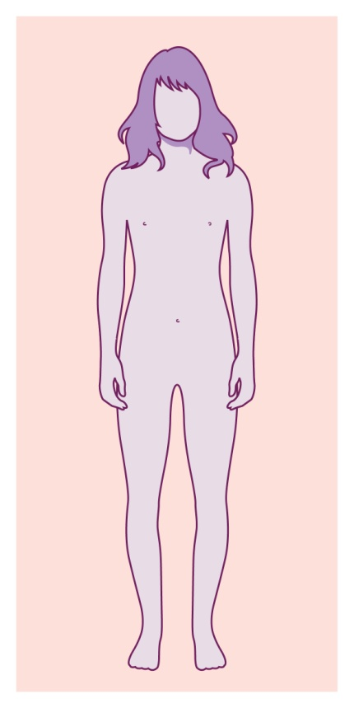
Changes to the body
Follow the link to discover female puberty online.
http://www.bbc.co.uk/science/humanbody/body/interactives/lifecycle/teenagers/index.shtml?girlGenitalsGo
Interactive Body
Female
Explore the body to discover the changes a girls goes through during puberty.
INTERACTIVE WEBSITE: www.bbc.co.uk
NB: Copyrights were not obtained for this material, so web links have been supplied for ease of reference

Slide 7
Outside of girls bodies

Slide 8
Outside of girls bodies
Draw a line to match the label with the correct body part
Pubic hair
Anus
Clitoris
Outer lips
Urethra
Inner lips
Vaginal opening

Slide 9
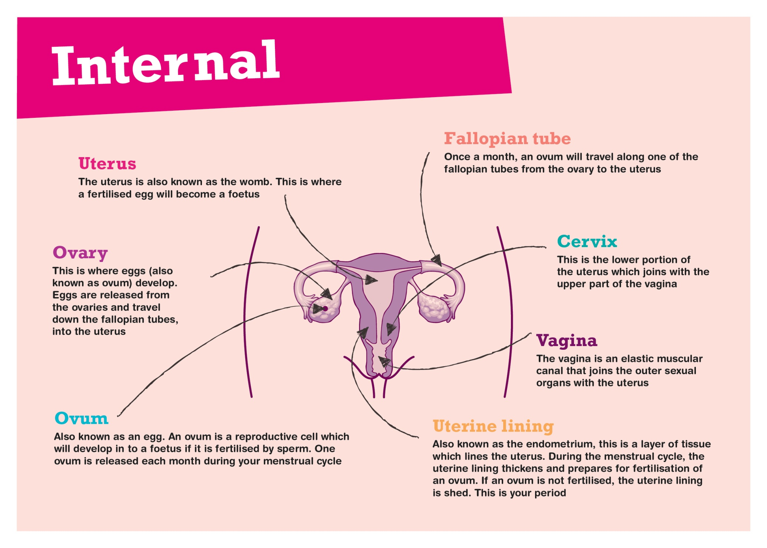
Inside girls bodies

Slide 10
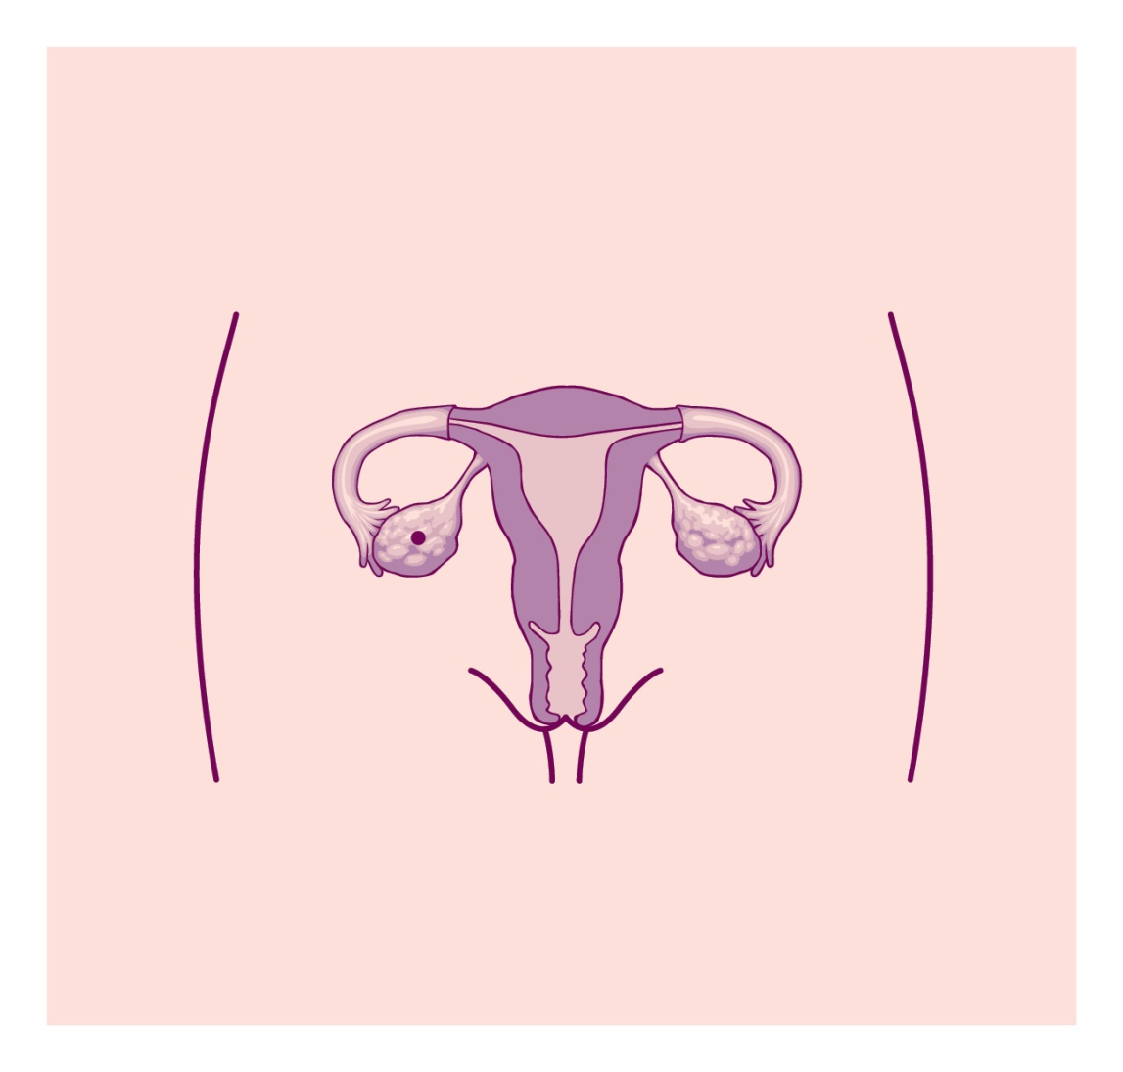
Inside girls bodies
Draw a line to match the body part to its' correct position
Uterus
Cervix
Uterine lining
Vagina
Fallopian tube
Ovary
Ovum

Slide 11
Inside girls bodies
Draw a line to match the description with the body part.
Where the egg develops
Also known as the womb
Reproductive cell which develops into a foetus
A layer of tissue which lines the uterus
An elastic muscular canal
Lower portion of the uterus
Once a month an ovum travels down this
Ovum
Uterus
Vagina
Ovary
Cervix
Endometrium
Fallopian tube

Slide 12
Extension: Female Puberty
Follow the link and take a 'Puberty body tour' of the female body
http://www.childrenfirst.nhs.uk/teens/life/puberty_body_tour/puberty_female_start.html
Puberty Body Tour
Female
What is puberty?
·Growing bigger
·Sprouting hair
·Your emotions
SOURCE: www.childrenfirst.nhs.uk
NB: Copyrights were not obtained for this material, so web links have been supplied for ease of reference

Slide 13
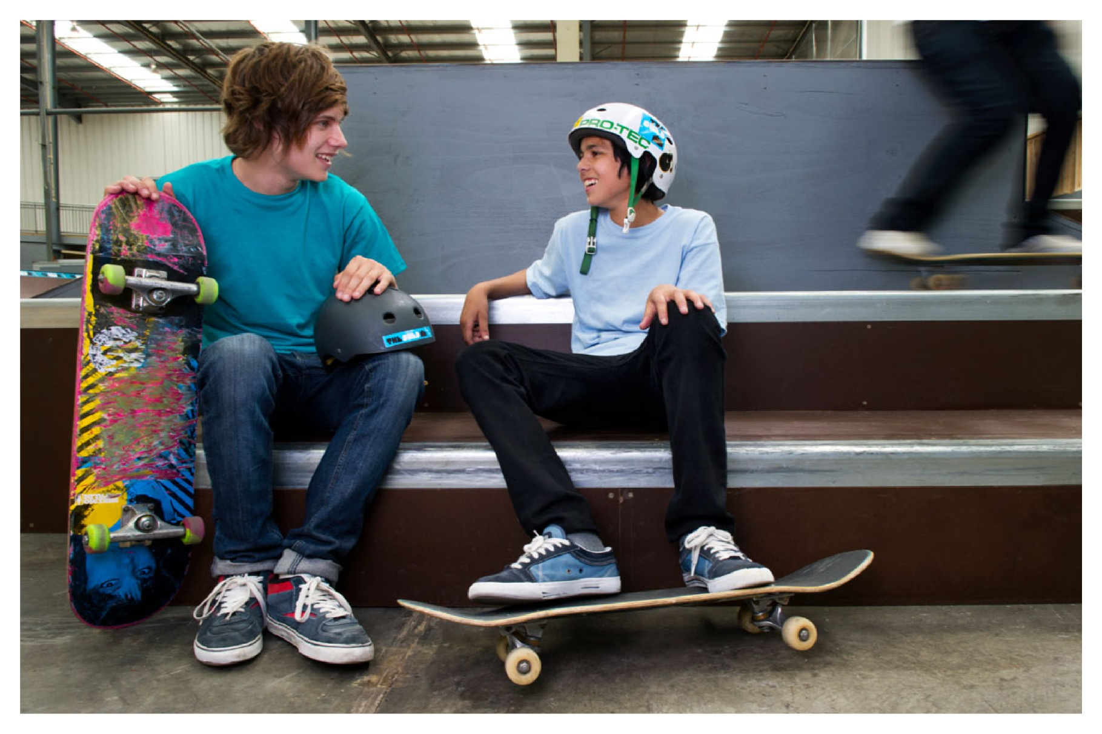
Puberty for Boys
Intro Video:
http://www.youtube.com/watch?v=oEkWMXa2684
NB: Copyrights were not obtained for this material, so web links have been supplied for ease of reference

Slide 14
What's happening to you?
Task: Brainstorm the physical and emotional changes that you think happen to the male body during puberty
Physical Changes
Emotional Changes

Slide 15
What's happening to you?
Answers:
Physical Changes
Emotional Changes
Sperm grows in testes
Fine pubic hair may begin to appear
Coarser, darker hair appears under the arms, around the pubic area, on the chest and on the face
Penis and scrotum get bigger and the shape changes
Height and weight increases & muscles become more prominent
Increased oil production can cause pimples
Increased tiredness
Erections start to occur
Uncontrollable emotions and mood swings
Sweat and body odour becomes more noticeable
Sexual desires develop and wet dreams start to occur

Slide 16
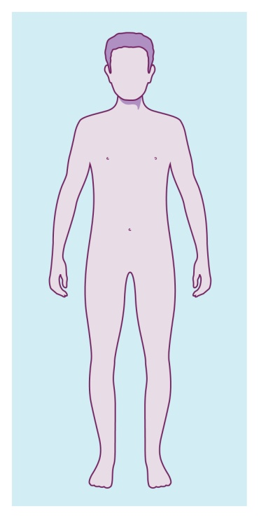
Changes to the body
Follow the link and take a 'Puberty tour' of the male body
http://www.childrenfirst.nhs.uk/teens/life/puberty_body_tour/puberty_male_start.html
Puberty body tour
Male
What is puberty?
·Growing bigger
·Sprouting hair
·Your emotions
SOURCE: www.childrenfirst.nhs.uk

Slide 17
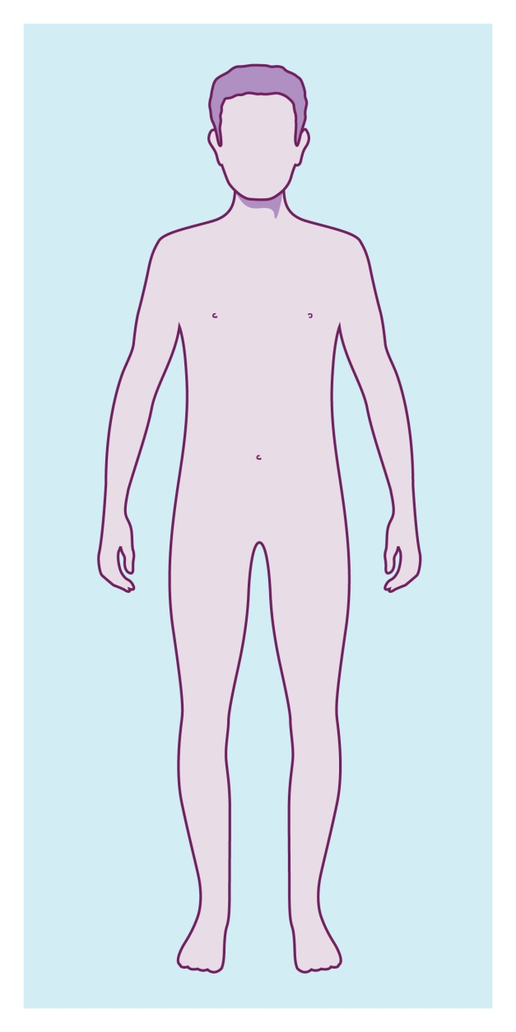
Changes to the body
Match the labels to the diagram
hair becomes
thicker
sperm grows
penis and scrotum
gets bigger
erections and
wet dreams
hair appears
pimples develop

Slide 18
Changes to the body
Answers for ‘Match the labels to the diagram’
pimples develop
hair appears
sperm grows
erections and
wet dreams
hair becomes
thicker
penis and scrotum
gets bigger

Slide 19
Outside of boys bodies

Slide 20
Inside boys bodies

Slide 21
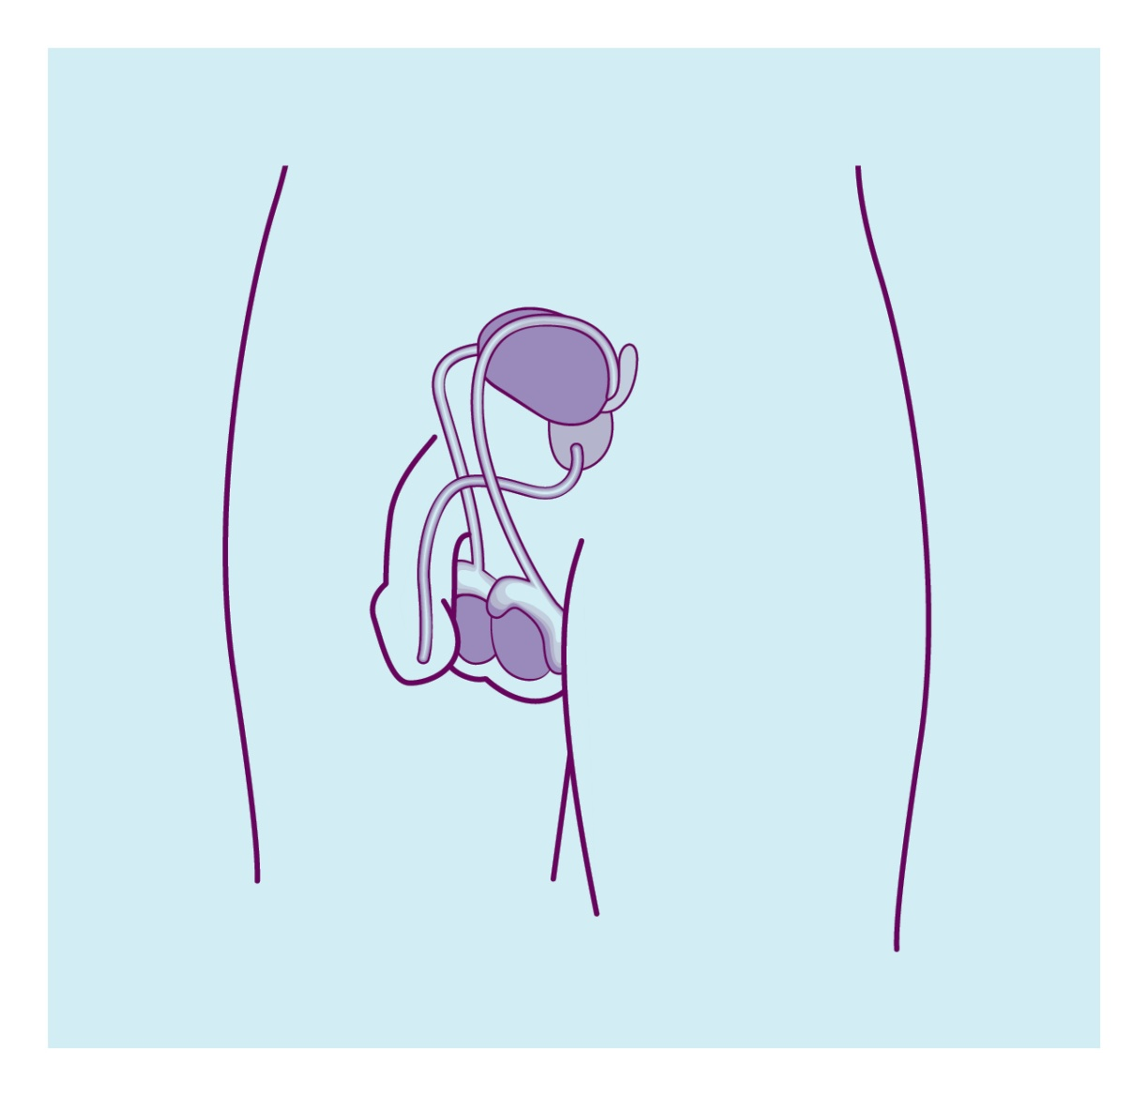
Internal body parts
Draw a line to match the internal body part.
Seminal vesicles
Testicles
Urethra
Prostate
Vas deferens

Slide 22
What's what?
Draw a line to match the word with the description:
The organ which produces sperm and testosterone.
Both semen and urine are released through this tube.
This coarse hair that develops during puberty.
Two thin tubes which carry sperm.
The thick loose skin covering the testicles.
Produces some of the fluid in semen.
The male sex organ, made of spongy tissue.
The skin covering the end of the penis.
Testicles
Pubic hair
Penis
Scrotum
Urethra
Vas deferens
Prostate
Foreskin

Slide 23
Extension: Male Puberty
Follow the link for more details on puberty in boys
http://www.aboutkidshealth.ca/howthebodyworks/Puberty-in-Boys.aspx?articleID=7713&categoryID=XS-nh3-06
Puberty in Boys
Male
What is puberty?
·Physically, puberty is a child's transition to sexual maturity.
SOURCE: www.aboutkidshealth.ca
NB: Copyrights were not obtained for this material, so web links have been supplied for ease of reference

Slide 24
Reference links:
Interactive Body for Girls
http://www.bbc.co.uk/science/humanbody/body/interactives/lifecycle/teenagers/index.shtml?girlGenitalsGo
Puberty Body tour for Girls
http://www.childrenfirst.nhs.uk/teens/life/puberty_body_tour/puberty_female_start.html
You tube clip:
http://www.youtube.com/watch?v=oEkWMXa2684
Puberty Body Tour:
http://www.childrenfirst.nhs.uk/teens/life/puberty_body_tour/puberty_male_start.html
Puberty in Boys:
http://www.aboutkidshealth.ca/howthebodyworks/Puberty-in-Boys.aspx?articleID=7713&categoryID=XS-nh3-06
NB: Copyrights were not obtained for this material, so web links have been supplied for ease of reference

