Slide 1
IQ3) How are Sound Waves produced and detected?

Slide 2
WINKS
3) Explain, using the particle model, the transmission of sound in different mediums.
a) classify a sound wave as a longitudinal wave
b) link volume and pitch to the amplitude and frequency of a sound wave
c) using the particle model, explain why sound doesn’t travel through a vacuum and travels fastest through a solid
d) identify and label the main parts of the ear: outer ear, eardrum, ossicles, cochlea, auditory nerve
e) describe how energy is transferred/transformed in the ear

Slide 3
1.5) What are Sound Waves?
Read and record this information about the practical we did on Thursday
Experiment) What are Sound Waves?
https://academo.org/articles/oscilloscope/
Part A and B)
– Sound is LOUDER when you put your ear on the desk
- Sound travels FASTER through SOLIDS than liquids and gases.
- This means they reach you ear with more ENERGY

Slide 4
Experiment) What are Sound Waves?
Part C)
– When a sound is made underwater and your ears are above the water, the sound will appear SOFTER and lower in PITCH
- Sound travels FASTER through SOLIDS AND LIQUIDS but not very far
- On the next slide is the speed of sound in various materials

Slide 5
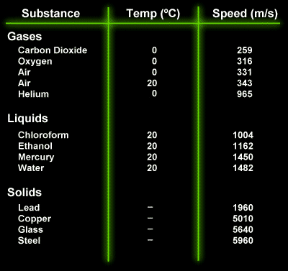
Do not need to write down this information into your books

Slide 6
Experiment) What are Sound Waves?
Part D)
– A tuning fork creates transverse waves on the water
- Sound Energy of tuning fork is transformed into Kinetic Energy in water
- Tuning Fork in Water in Slow Mo

Slide 7
Experiment) What are Sound Waves?
Part E)
– LOUD sound has a _____________ ___________
- SOFT sound has a __________ _______________
- HIGH note (or pitch) has a _________ ___________
- LOW note (or pitch) has a __________ _____________
Word List – words can be used more than once
Amplitude, Frequency, Large, Small

Slide 8
Experiment) What are Sound Waves? conclusions
Sounds travel FASTEST in solids but not very far
LOUD sound has a LARGE amplitude
HIGH note (or pitch) has a LARGE frequency

